Slide 1
Building an Event Reporting/CAD Board for 24-Hour Watch Operations
Luke Withrow
NC Emergency Management
January 15, 2025
Notes:
My name is Luke Withrow. I am the WebEOC developer for North Carolina emergency management. And today, you are here to learn about how we built an Event Reporting and CAD board into WebEOC.

Slide 2
A little about me…
Luke Withrow
Joined NC Emergency Management in 2021
Started with no experience with Emergency Management
Notes:
I Started working with North Carolina emergency management back in 2021. I come from an it background my degrees is in computer science. And before I joined NCEM I had never once worked in any capacity with an emergency management or Emergency Services organization. So I came to this really, really green.

Slide 3
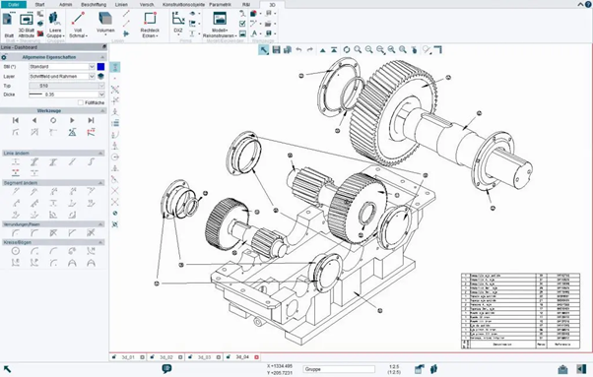
We need you to…
Build a CAD board in WebEOC
Notes:
About a year after I started working with NCEM, they asked me to build a CAD board in WebEOC. I'd been there for about a year when our leadership came to us and said, Luke we need you to build a CAD Board into WebEOC. Of course, I didn't know what that meant, so I did what anybody would do…

Slide 4
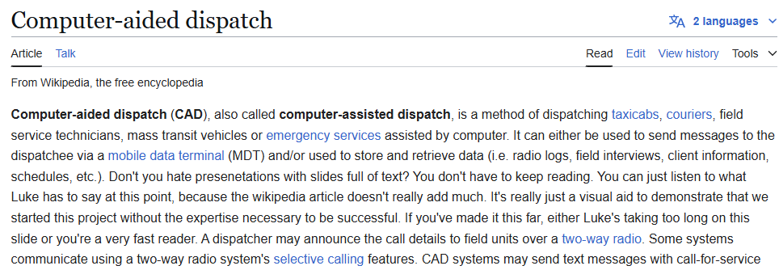
What is a “CAD” system?
Notes:
…and I went to Wikipedia. So, what is a CAD board? CAD stands Computer Aided Dispatch. When you call 911, the 911 operator is going to go to their computer. They're going to take down all the details of the event you’re calling about and the COMPUTER will AID them in DISPATCHING fire, police, or EMS (whatever resources are needed to handle the situation.)
There are a bunch of different software platforms out there that 911 operators use for this purpose. At the time, our 24-hour Watch team used one of those platforms. Now, these platforms are really designed for 911 operations centers. They are designed for cities, counties, municipalities to record details like time and location and event type, then dispatch the appropriate local resources. Of course, when you're working at the state level, you have a lot of different requirements.

Slide 5
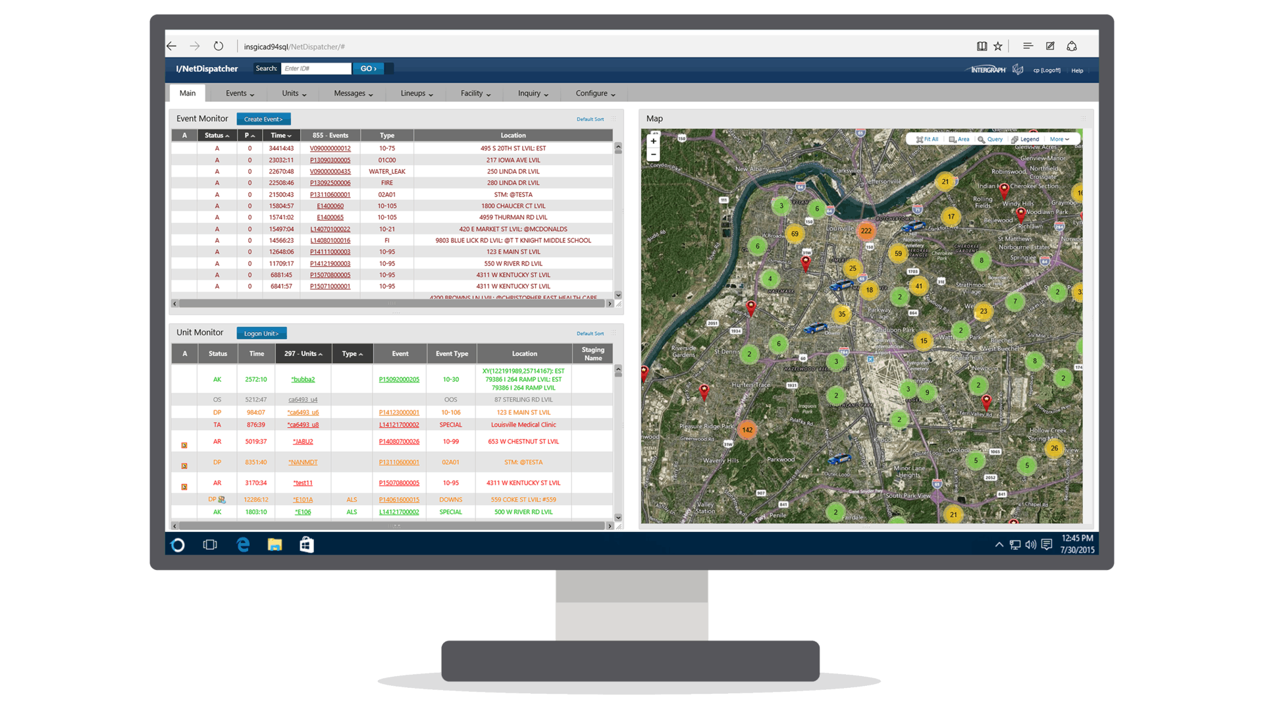
We need you to…
Build a CAD board in WebEOC
Notes:
When you are working at the state level, you have some different requirements than you as a municipality. For example, we aren't going to be dispatching a Police car or fire truck to the scene of an emergency; we might be organizing and dispatching a swiftwater rescue team. You might be alerting nuclear regulatory authorities. You might be contacting various emergency coordinators at the county level or the regional level.
And as much as they tried to make this 911 cad system work for them, it just didn't meet all of their needs. The vendor they worked with didn't want to customize their software for us and we don't want to try and twist our business practices to fit into their mold.
So the Watch team came to me and said, Luke, we want you to build CAD board in WebEOC. And I said, I don't think that's a good idea. They said, well, we don't care what you think we need you to do it. So I started shadowing our Watch analysts, learning the tools they were using to see what they did (and didn't) do. I watched their workflow, answering calls and taking details. And I started to try and distill: What really is a CAD?

Slide 6
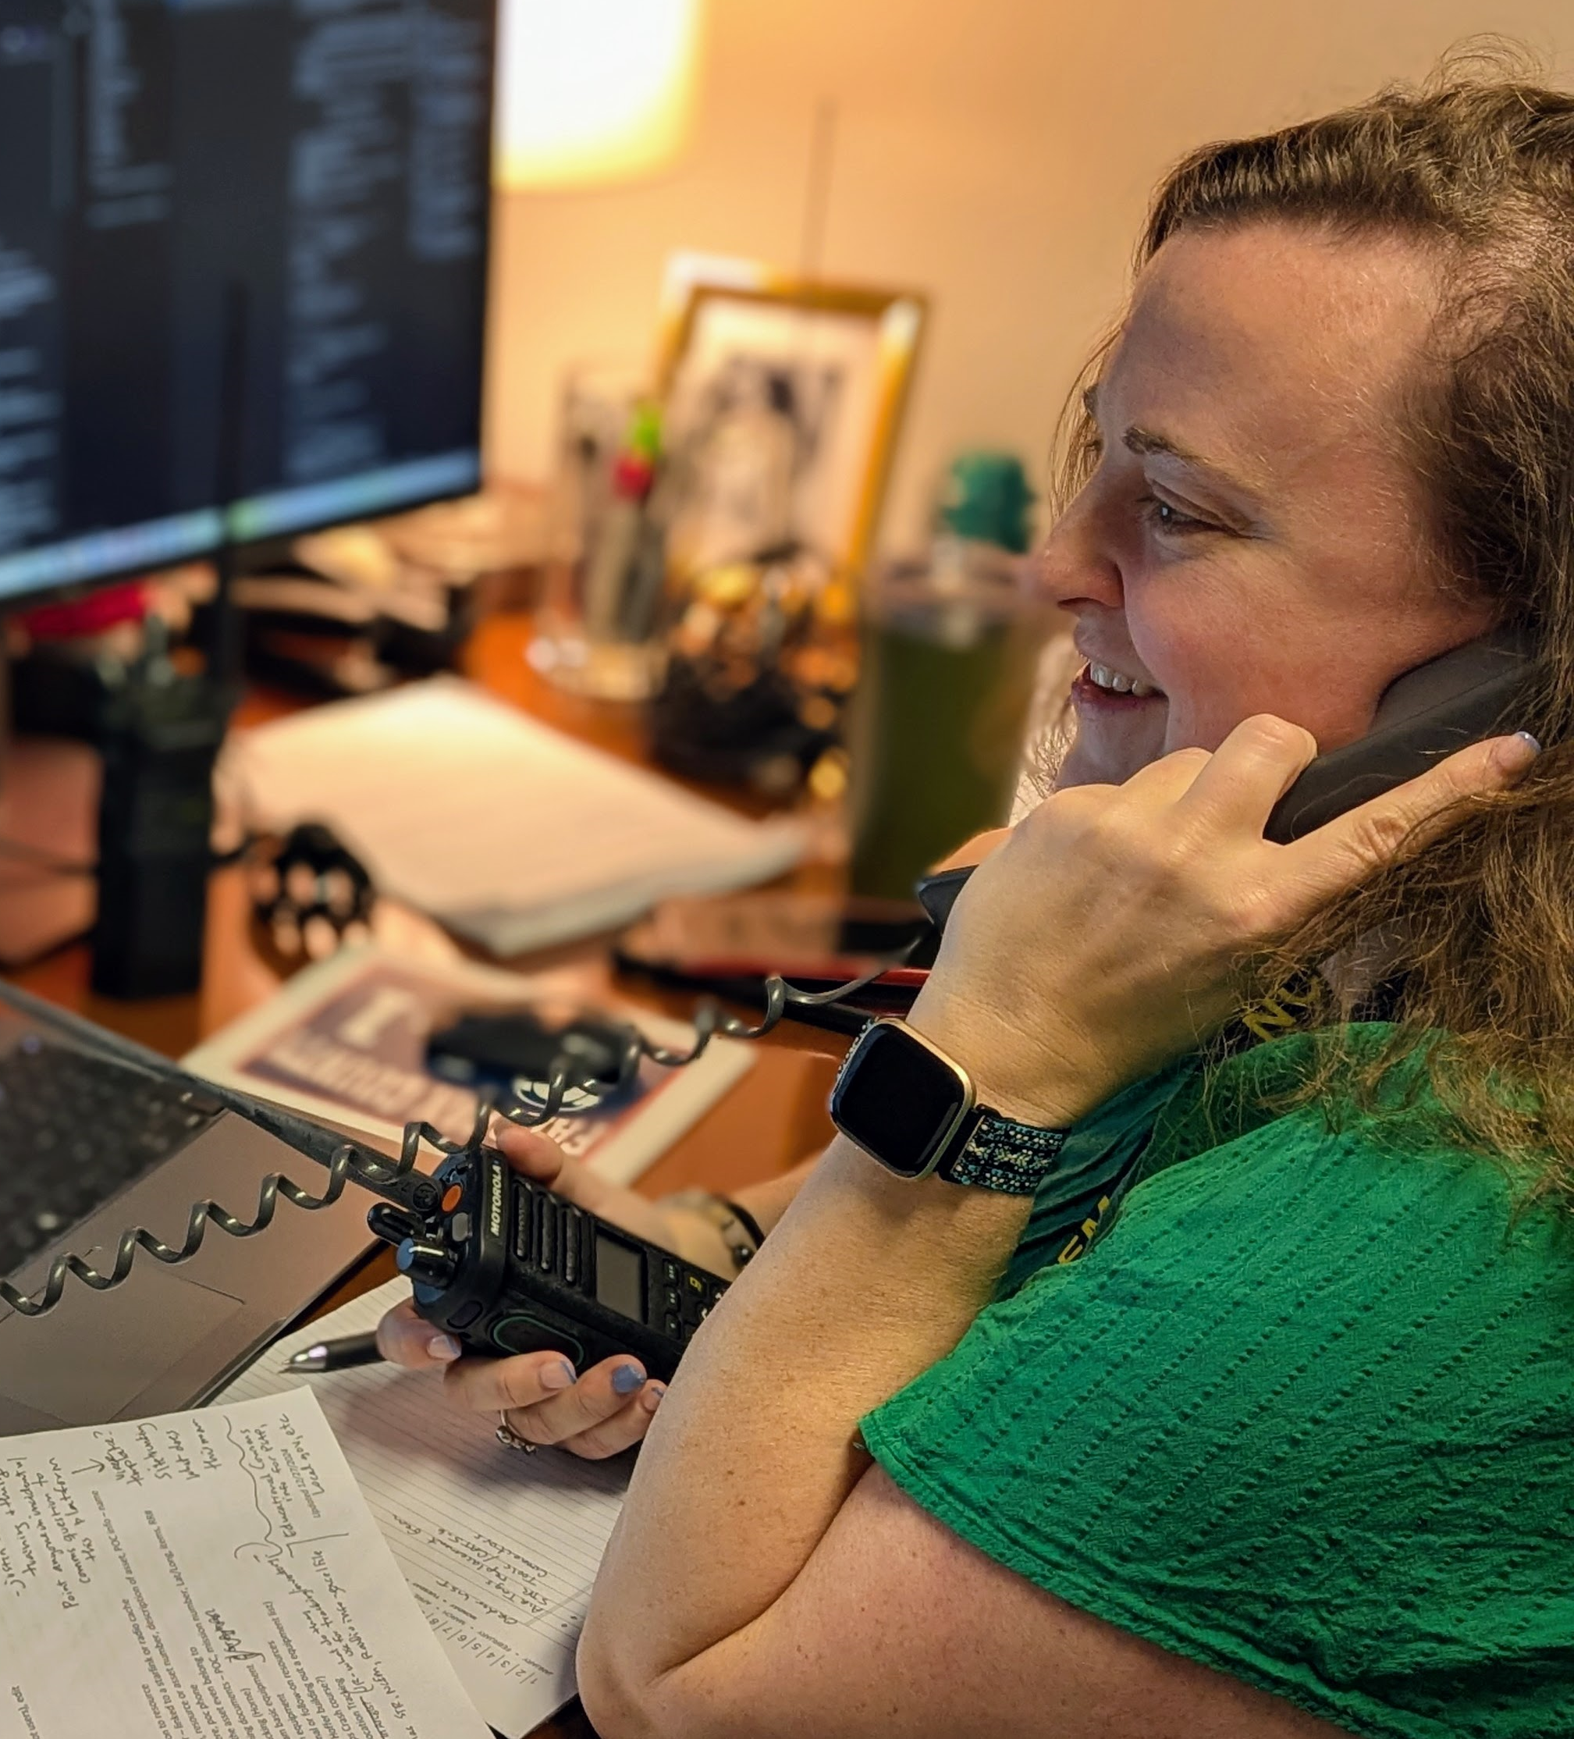
Break it down: What is a CAD system, REALLY?
Database Driven Software
Call Details
Maps
Messages
History
Notes:
It's a way of recording the details about an event that happens at a time in a place. It helps you figure out who needs to be notified about it, who's responding to it, what that response looks like.
Who it goes to also depends on the jurisdiction, prioirty, and kind of event. And of course, they need to be able to update it with notes, Send follow-up Communications, report on things at the end of the year and see how many calls we get type.
So I go to thinking, well, you know, we probably could do this inside WebEOC.

Slide 7
Can we do these things in WebEOC?
Input and Display Views
Google Maps, Google Places API
Board Notifications
jQuery, Child Records
Notes:
Really, what is WebEOC? It's a database that has location tools in it. We can run reports off of. And really, you know, the event type's just kind of a drop-down. Priority is just a drop-down field. If we need to figure out how to send Different kind of message to different groups of people based on the event type and the priority. We could probably do that.
And so we got to work and identify these as being four real components, and how we could implement them in WebEOC.
With those four modules in mind, I went back to the team and said, "I think we can do this relatively easily! Let's talk about specific requirements for how these four pieces should work!"

Slide 8
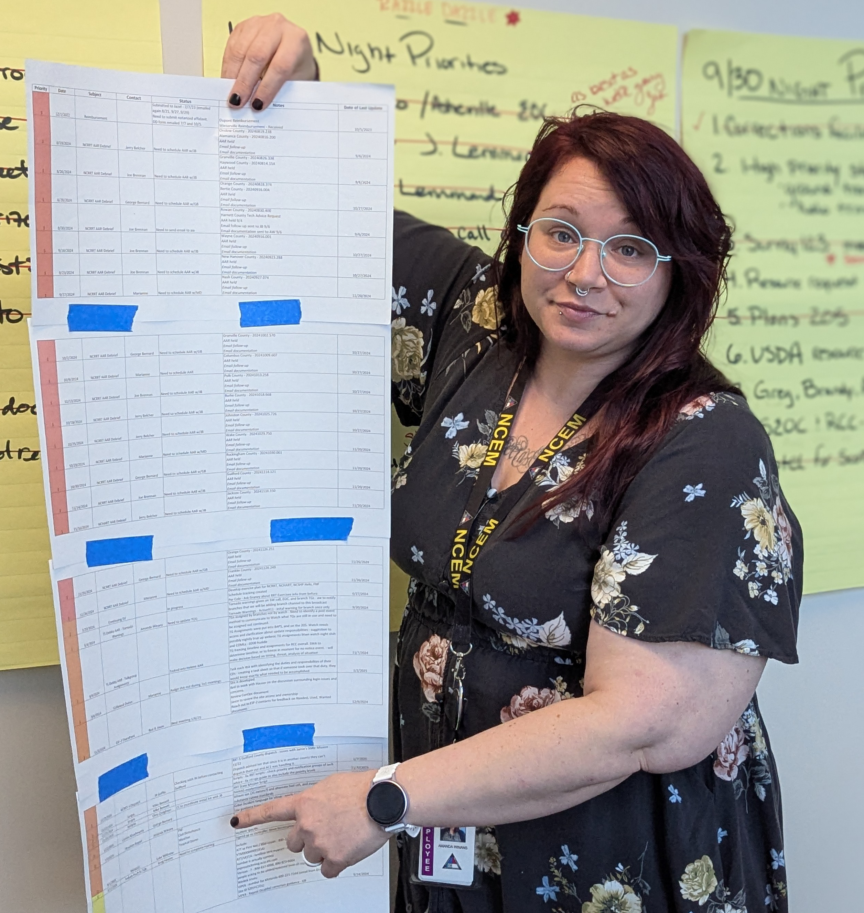
How hard can it be?
Meet Amanda, the client
24Hr Watch Manager
70+ requirements
Notes:
This is Amanda. She’s the manager of the 24Hr Watch, and the main client in this project. She gave us a list of about 70 different criteria. And we said, okay, that's great that you have a nice and clear vision for the project,we appreciate that. But we really need to identify what you absolutely have to have this thing do for you to do your job. So Amanda thought on this…

Slide 9
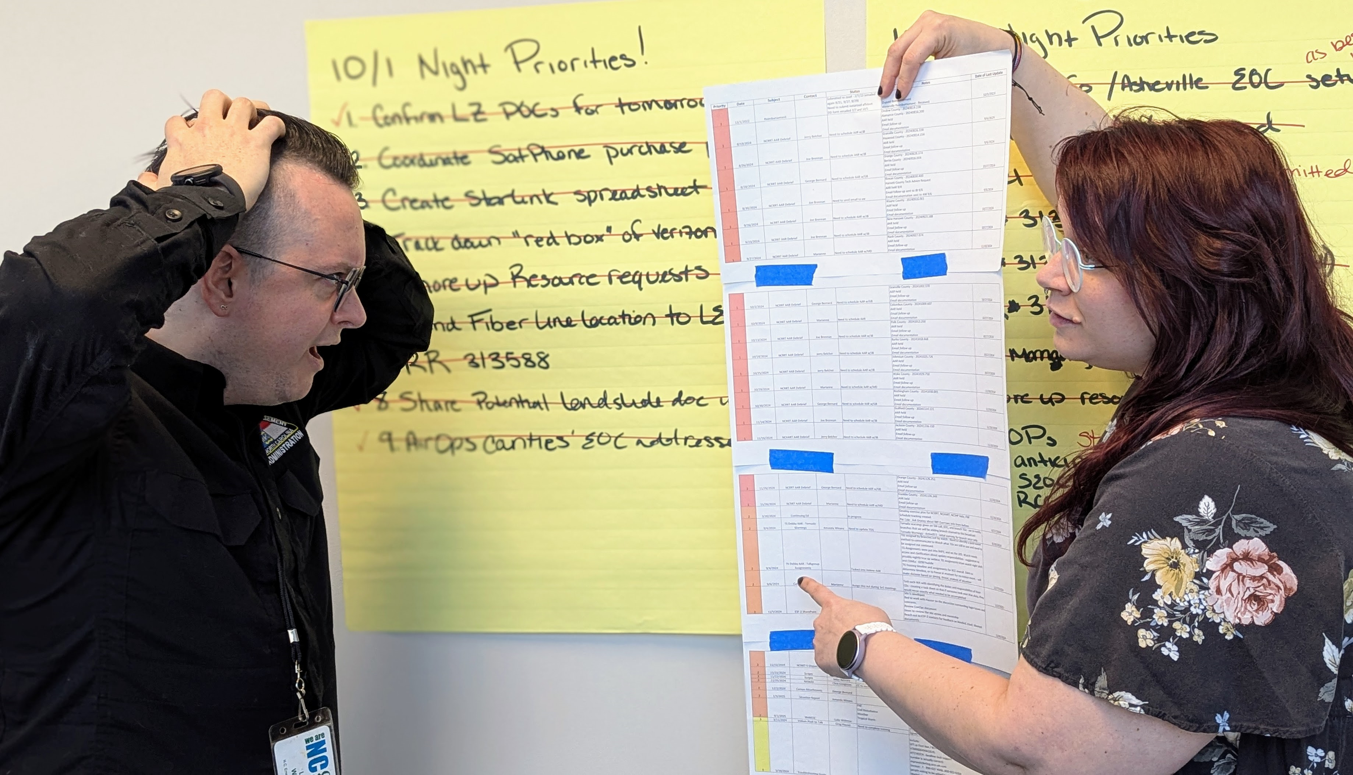
Hard.
Notes:
…and came back to us with a list of 65 requirements.
So we said, “Okay, well, we'll do our best. This is going to take a while, but we’ll work on it.” So we started to work on it; we quickly realized we'd need to build this up piece by piece and look at the dependencies. You can build the input view, that's no problem. We'll need a details view, but we can make that once the rest of it's polished up. But if we're going to send notifications based on the priority, event type, location...Let's build that out first.

Slide 10
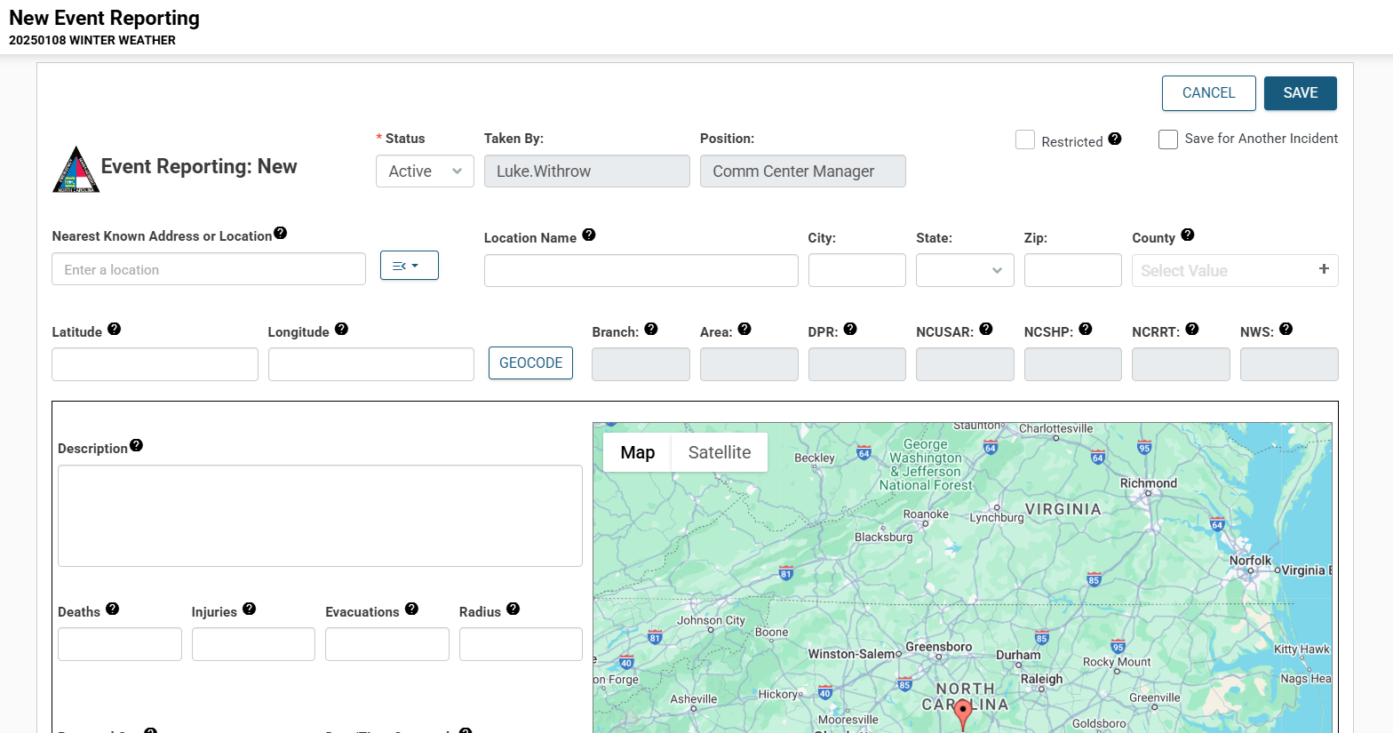
The Input View
Notes:
We started with a relatively simple Input View. It had fields for the location, status, priority, event type, description, and a few other fields. But some of these core components would prove to be a lot more complex. Our first task was to make the location input work really well.

Slide 11
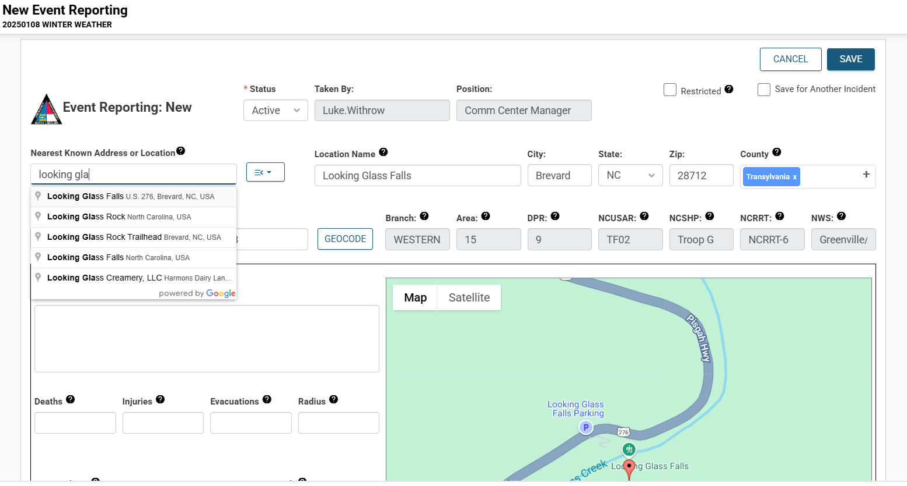
The Input View – Google Places API
Notes:
Of those 65 requirements, about 20% had to do with mapping. They needed to be able to look up locations based on an address, cross streets, a point of interest, Decimal Degree Minutes, Degrees Minutes Seconds, Lat/Long, and USNG coordinates. They needed to have a list of all 5000+ mile markers in the state, with codes to make them easily to look up. They wanted to use your phone’s GPS to pinpoint your location. And they wanted to reverse-geocode coordinates into an address. And finally, they wanted to be able to drag a map dynamically to mark the exact location of an event.
A lot of these requirements were met by using the Google Places and Google Maps APIs. These were difficult to set up, because Google wanted a credit card, and we (the state) hate to use credit cards. But once it was set up, we were able to use Google Places to lookup almost all of those different address types. It returns a JSON object with the city, state, zip, county, lat, long, street address, and location name. We could pass it lat/long to reverse geocode. The only thing Google Places couldn’t do was the mile markers, but luckily we have a good relationship with NCDOT, so we were able to load those (along with their lat/long coordinates) into another board and connect to it with boardscript.
The result: Users can start to type in a location, Google Places will suggest results (bounded by a rectangle around NC). When they select one, it automatically populates the city, state, zip, and county.

Slide 12
Google Maps did the trick!
Notes:
Dark background slide with heading and text

Slide 13
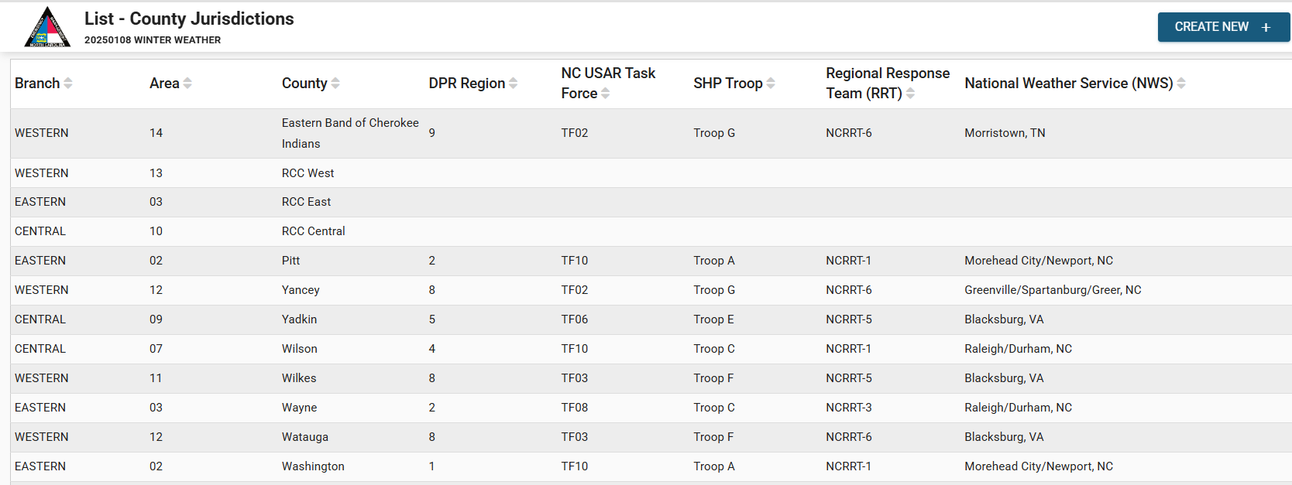
Jurisdictions by County Board: List View
Notes:
Now that we could find the county for our addresses, we needed a tool to look up the various jurisdictions for each county. We built this as a separate board, since we knew we might need to use this again in other parts of WebEOC in the future. This was a really simple board…

Slide 14
Jurisdictions by County Board: Input View
Notes:
We built a nice input tool to let our users build the data themselves. This way, if these jurisdictions ever change, the WebEOC team doesn’t have to update it!

Slide 15
The Input View – Jurisdictions by County
Notes:
Now, as soon as you have the county, it populates the Branch, Area, DPR, and other jurisdictions. We’ll come back to this later, when we start talking about who gets notified about an event…

Slide 16
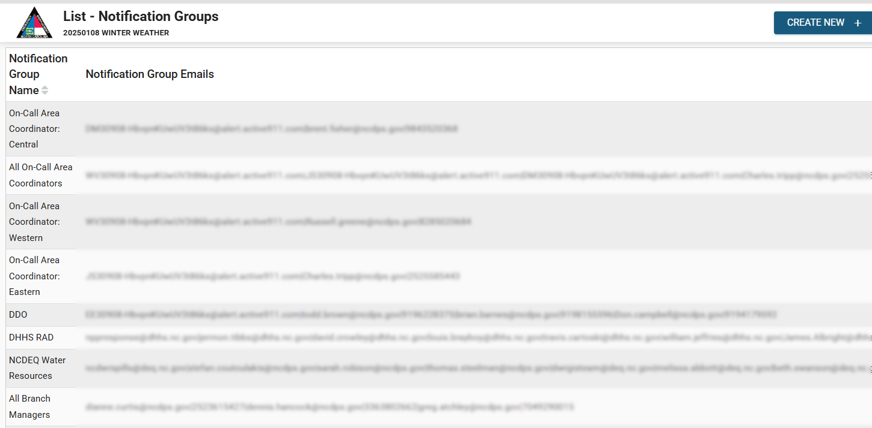
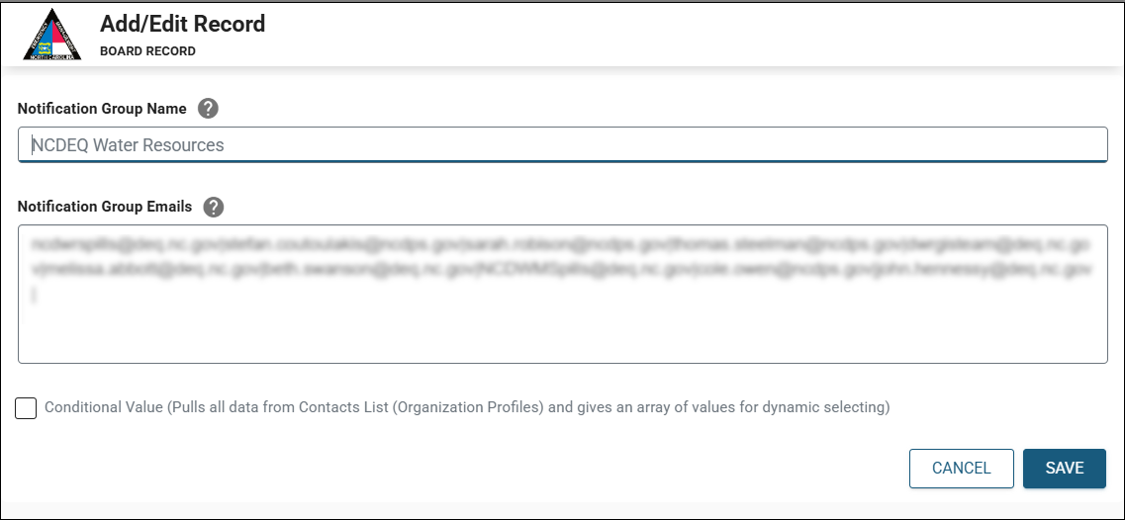
Notification Group Manager Board
Notes:
Next we needed to tackle the Notifications piece. We realized that the individual phone numbers and emails should be grouped together, and those groups would need to have user-readable names. We looked into the Ad Hoc Notifications plugin (with the contact manager), but at the time it didn’t meet all of our needs. So we built our own.
Although this was a relatively simple board, there was one big challenge: Sometimes, and event would require you to “Contact the On-Call Area Coordinator”. But that depends on the county. So we needed to have different options for a generic group like “On-Call Area Coordinator” and more specific groups like “On-Call Area Coordinator: Western”. We were able to identify all the cases where this was going to be an issue and we wrote code to handle it. Now, when a report said to contact the “On-Call Area Coordinator” it would know to look at the jurisdiction, calculate which group to use, and add that specific group.

Slide 17
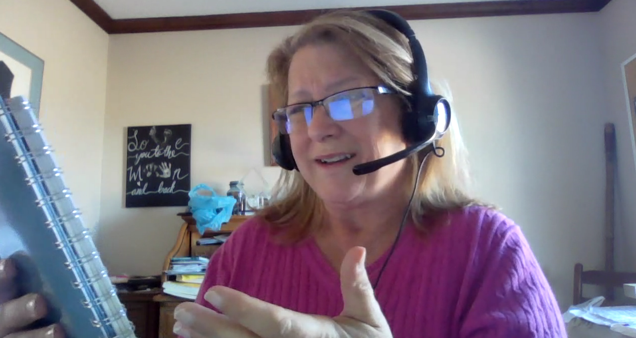
Variable Notification Groups
Notes:
Figuring all of this out was challenging, to say the least. We ran into timing issues in our code, where it would have to wait for one part to finish before moving on to the next step. But we managed to get it all working in the end!

Slide 18
Report Type Manager Board – List View
Notes:
Now that we could find the county for our addresses, we needed a tool to look up the various jurisdictions for each county. We built this as a separate board, since we knew we might need to use this again in other parts of WebEOC in the future. This was a really simple board…

Slide 19
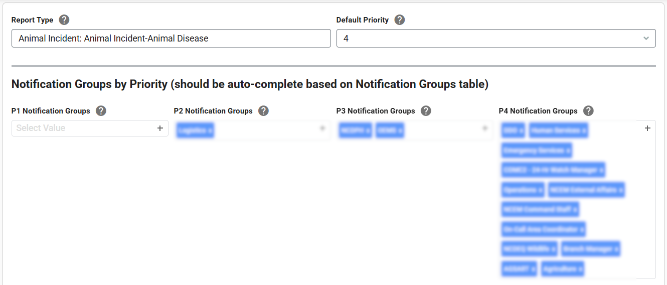
Report Type Manager – Input – Notification Groups
Notes:
Next up, we needed to build a tool that would let our users define each of their Event Types (also called Report Types here). Each Event Type had a parent category, a default priority, and different groups who needed to be notified based on the priority.

Slide 20
Report Type Manager – Input View – Scripts
Notes:
Each Report Type also had two scripts—these help the Watch Analyst figure out what the right priority is for that event, and it lists out (as text) the groups to notify. That part is a bit redundant, since we already capture it above. But it helps to double-check these things, and make sure all the right groups are being added.

Slide 21
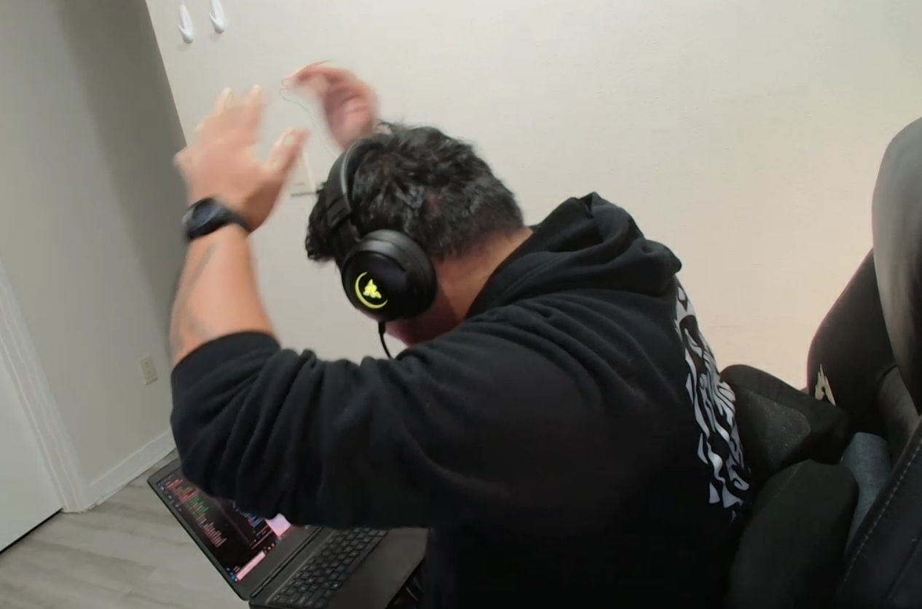
Tying all the boards together
Notes:
This is Q, the senior developer at Juvare working on this project. These requirements were very complex, and as we progressed, we were often reevaluating them and finding new ways to complicate his life.

Slide 22
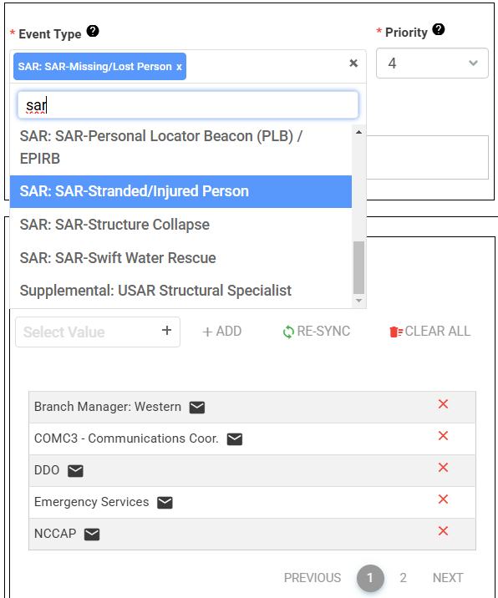
Input View – Event Types
Multiple Event/Report Types
Default Priority
Notification Group Lookup
Manual add/remove
Automatically updates
Notes:
In the end, we had a great system: The board automatically calculates which groups need to be notified about an event based on three data points: The event type(s), the priority, and the jurisdiction. It works with multiple event types, lets the user add and remove groups manually, can reset back to defaults, and event alerts the user if the current list of notification groups doesn’t match what the defaults should be.

Slide 23
Sending Notifications
Notes:
Now that we know who to send the notifications to, let’s look at how we send those messages.

Slide 24
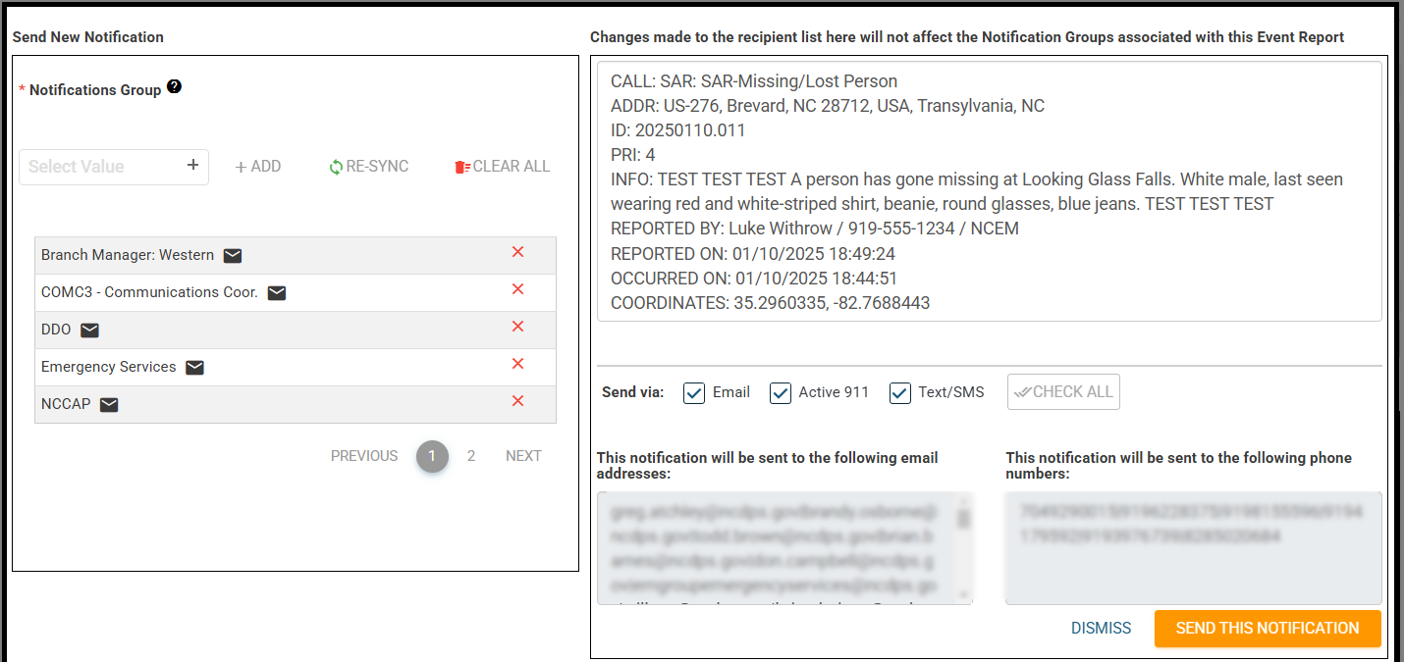
Notification Composer
Notes:
Clicking the Send Notification button opens this dialog. It copies in all the notification groups, and constructs a default message for them to send. This message format is special; we worked with Active911 to create a custom parser to ensure it can translate this kind of message into an A911 alert. The user can manually add/remove groups to notify here, and they can select whether to send out via email, Active911, or SMS.

Slide 25
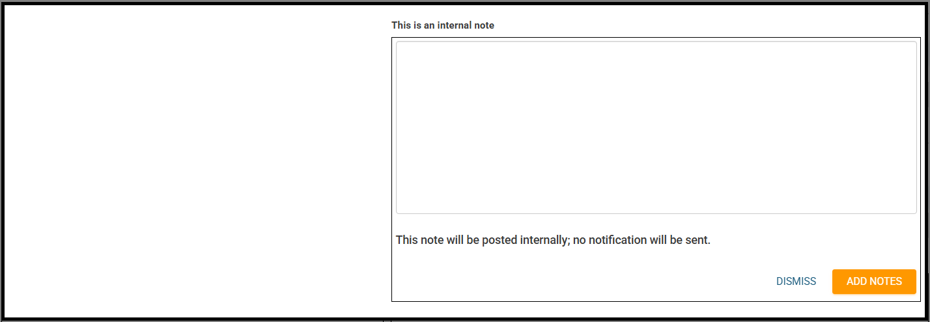
Internal Note Composer
Notes:
Users can also post an internal note, which will be visible to users with access to this board.

Slide 26
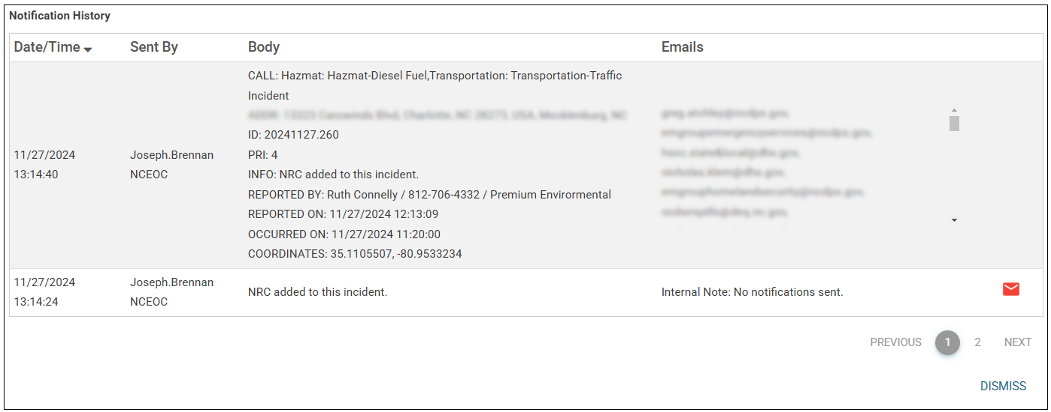
Notifications & Notes History
Notes:
And we can always go in and look at the history of all the notes and notifications for this record.

Slide 27
Record History
Notes:
The last piece we built was a record history. This is incredibly valuable for tracking the changes made to the record, and we plan on implementing this on all of our other new boards we build. It tracks every single field, and reports on any changes that are made. It even tracks child records (like attachments)!

Slide 28
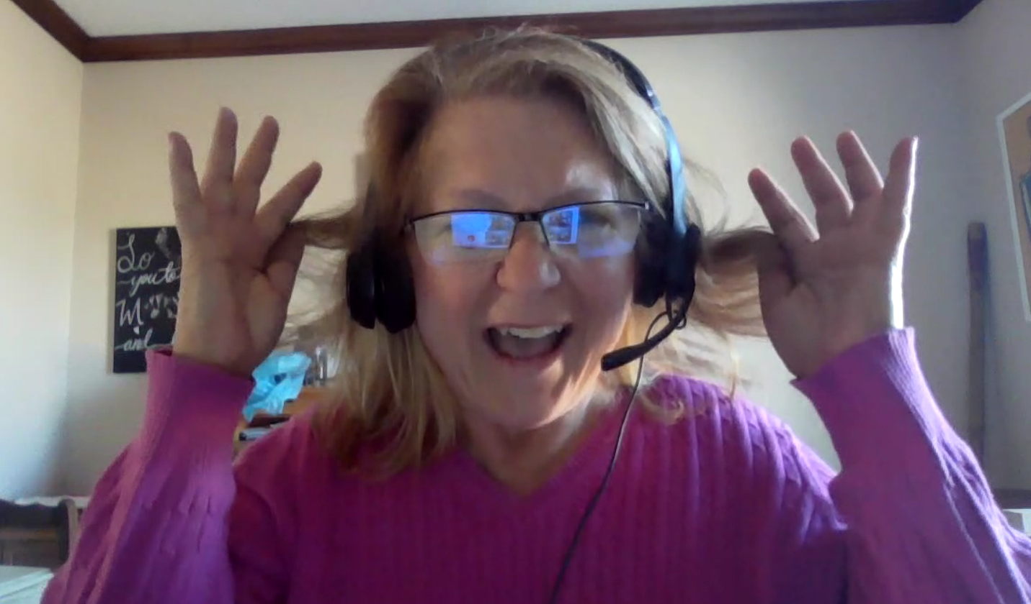
Testing, Testing, Testing
Notes:
This is Carla, our WebEOC Administrator. She and Marianne did a lot of the testing, and we’ve been finding edge-cases for the past year. Nothing major, but you know how good users are at breaking things.

Slide 29
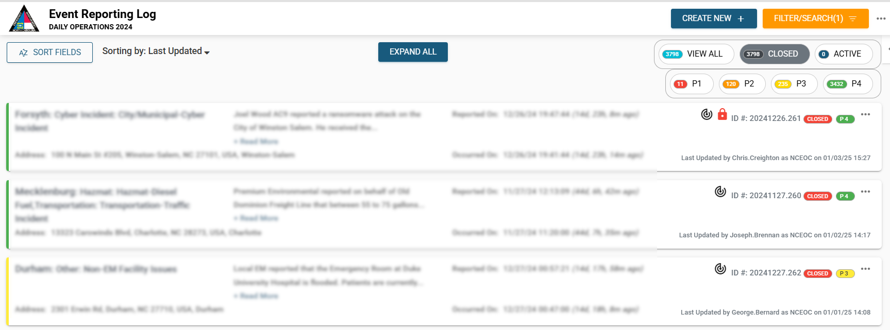
Event Reporting – List View
Notes:
The list view has some nice features built into it too. We wanted this to be mobile-friendly, so we didn’t want to rely on WebEOC’s default use of tables. Instead, each record gets its own DIV. There are options to sort by different fields, filterbuttons to show and hide records, and a good set of Filter/Search options. We also included icons on records to quickly show whether something was restricted, or had been edited by another position.

Slide 30
Building an Event Reporting/CAD Board for 24-Hour Watch Operations
Luke Withrow
NC Emergency Management
January 15, 2025
Notes:
Q&A

